Slide 2


Analysis of FPAs in the LHC RB circuit
Christoph Obermair, TE-MPE-CB Lukas Felsberger, TE-MPE-MI Franz Pernkopf, TU-Graz Andrea Apollonio, TE-MPE-CB Daniel Wollmann, TE-MPE-CB

Slide 3
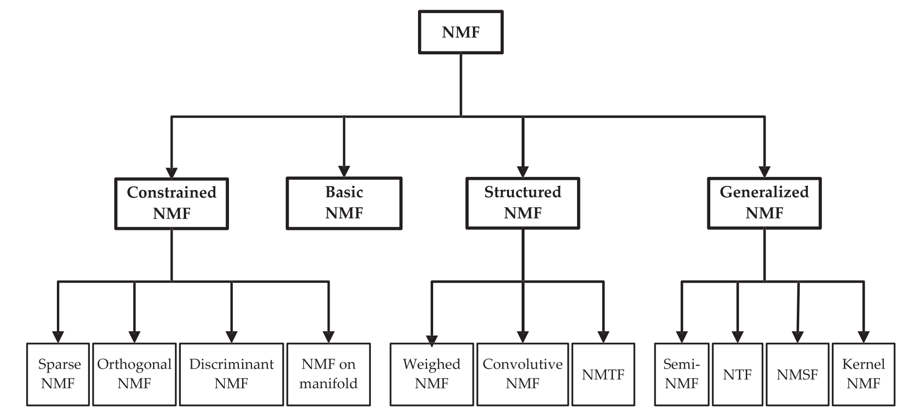
Non-Negative Matrix Factorization

Slide 4
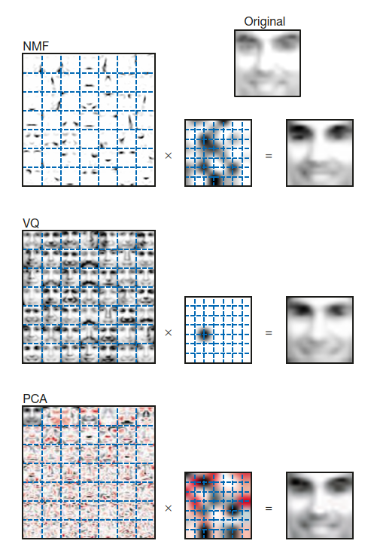
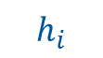
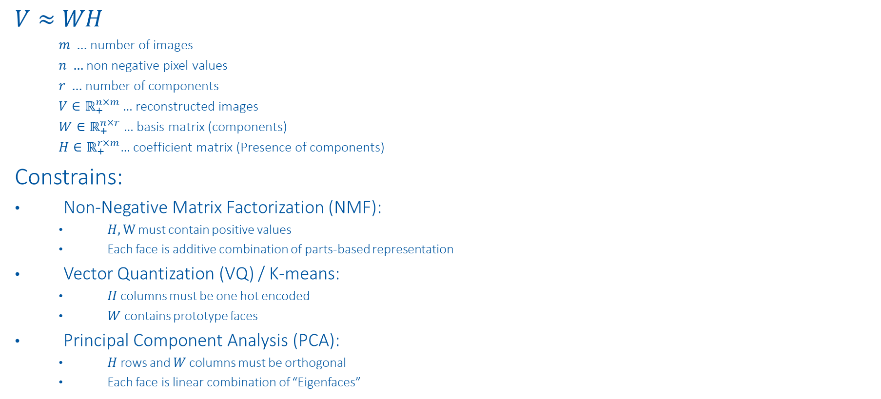

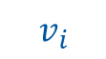
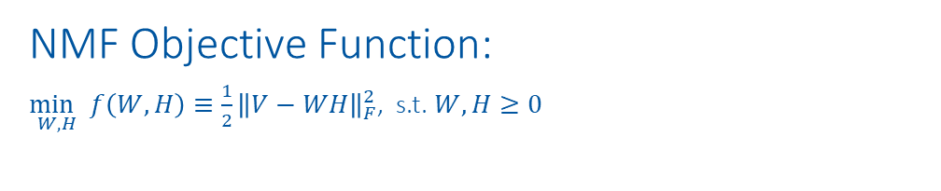
NMF vs. VQ vs. PCA
$$W$$
$$h_{i}$$
$$V≈WH$$
$m …$ number of images
$n …$ non negative pixel values
$r …$ number of components
$V∈ℝ_{+}^{n×m}$… reconstructed images
$W∈ℝ_{+}^{n×r}$… basis matrix (components)
$H∈ℝ_{+}^{r×m}$… coefficient matrix (Presence of components)
Constrains:
Non-Negative Matrix Factorization (NMF):
$H,W$ must contain positive values
Each face is additive combination of parts-based representation
Vector Quantization (VQ) / K-means:
$H$ columns must be one hot encoded
$W$ contains prototype faces
Principal Component Analysis (PCA):
$H$ rows and $W$ columns must be orthogonal
Each face is linear combination of “Eigenfaces”
NMF Objective Function:
$\underset{W,H}{\min{ }}f\left(W, H\right)≡\frac{1}{2}{\left\|V−WH\right\|}_{F}^{2}$, s.t. $W, H≥0$
$$v_{i}$$
https://www.nature.com/articles/44565
https://proceedings.neurips.cc/paper/2000/file/f9d1152547c0bde01830b7e8bd60024c-Paper.pdf

Slide 5
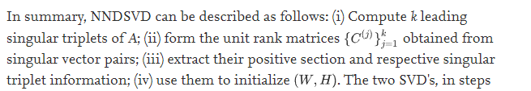
NMF sensitivity analysis
Values to vary:
Initialization:
'nndsvd': Nonnegative Double Singular Value Decomposition (NNDSVD)
'nndsvda': NNDSVD with zeros filled with the average of X
Regularization:
None, L1, L1+L2, L2
On Transformation (H), and Components + Transformation (W + H)
Weight
Orthogonal Loss
Shuffle: True, False
*SVD based initialization: A head start for nonnegative matrix factorization

Slide 6
Merge Components and retrain

Slide 7
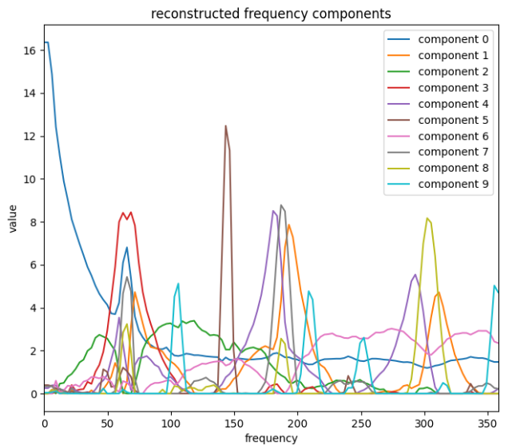
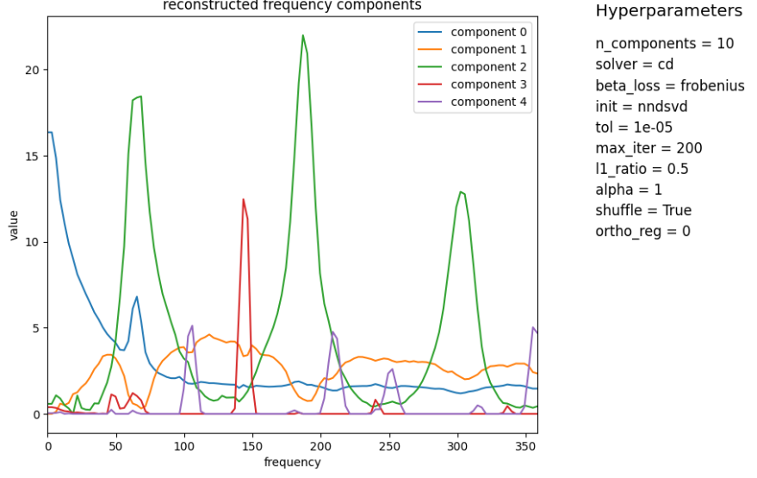
Merge components

Slide 8
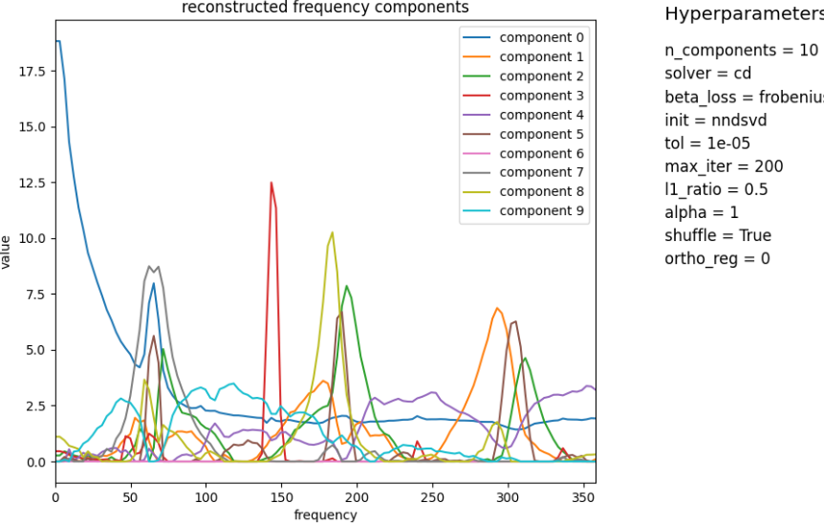
Retrain components with merged init

Slide 9
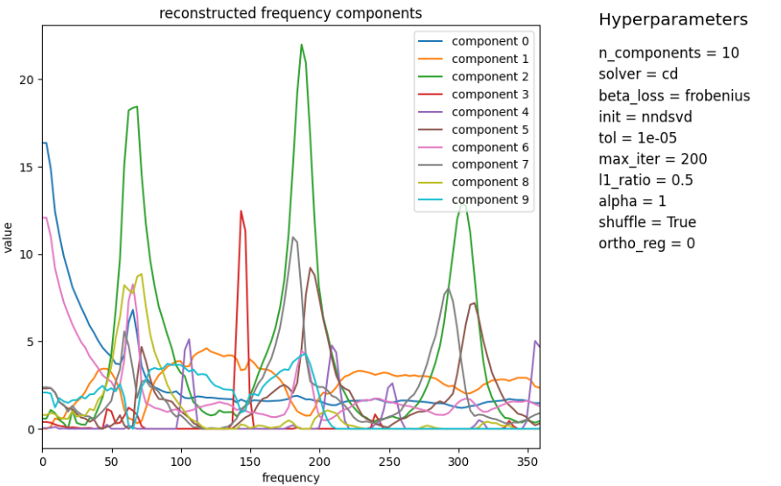
Retrain not merged components

Slide 10
Regularization

Slide 11
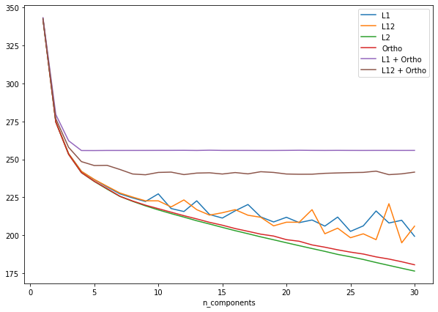
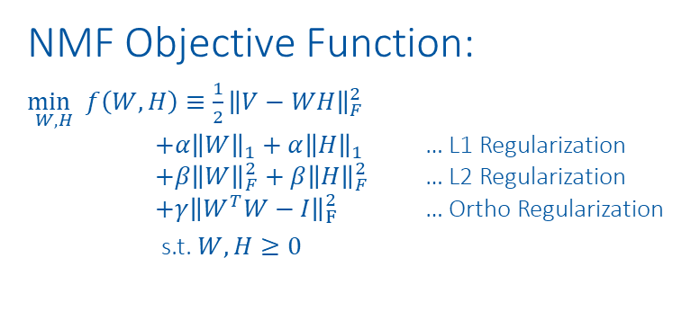
Regularization
NMF Objective Function:
$\underset{W,H}{\min{ }}f\left(W, H\right)≡\frac{1}{2}{\left\|V−WH\right\|}_{F}^{2}$ $+α{\left\|W\right\|}_{1}+α{\left\|H\right\|}_{1}$ … L1 Regularization $+β{\left\|W\right\|}_{F}^{2}+β{\left\|H\right\|}_{F}^{2}$ … L2 Regularization $+γ{\left\|W^{T}W−I\right\|}_{F}^{2}$ … Ortho Regularization
s.t. $W, H≥0$

Slide 12
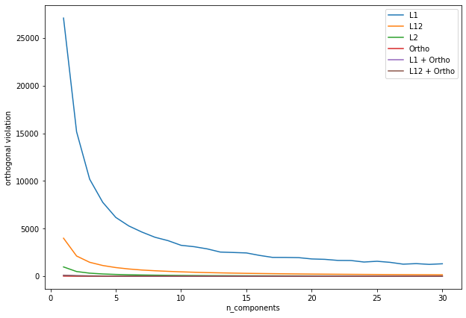
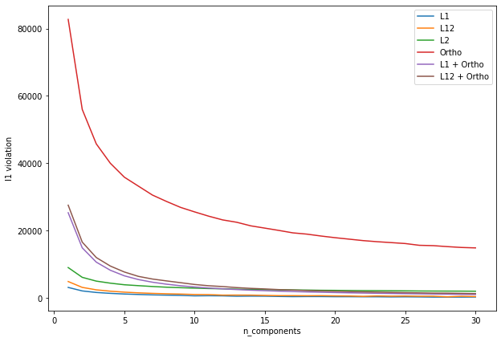
Regularization
NMF Objective Function:
$\underset{W,H}{\min{ }}f\left(W, H\right)≡\frac{1}{2}{\left\|V−WH\right\|}_{F}^{2}$ $+α{\left\|W\right\|}_{1}+α{\left\|H\right\|}_{1}$ … L1 Regularization $+β{\left\|W\right\|}_{F}^{2}+β{\left\|H\right\|}_{F}^{2}$ … L2 Regularization $+γ{\left\|W^{T}W−I\right\|}_{F}^{2}$ … Ortho Regularization
s.t. $W, H≥0$

Slide 13
Gifs Hyperparamters

Slide 14
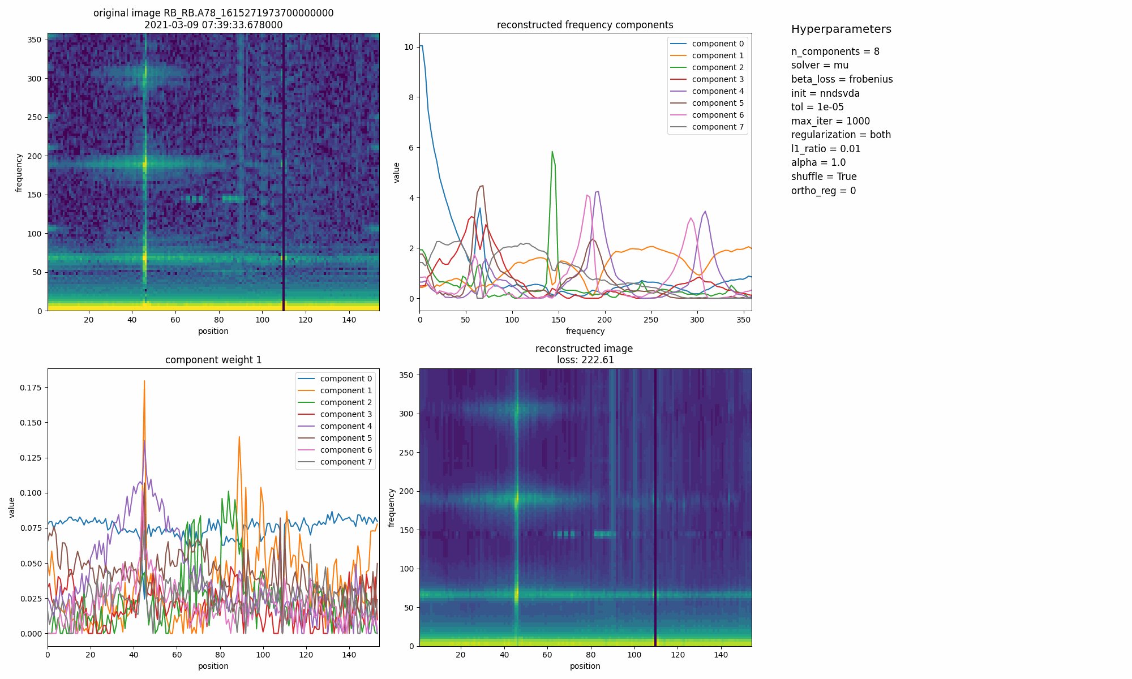
Regularization: L1 (l1_ratio=1) vs. L2 (l1_ratio=0)

Slide 15
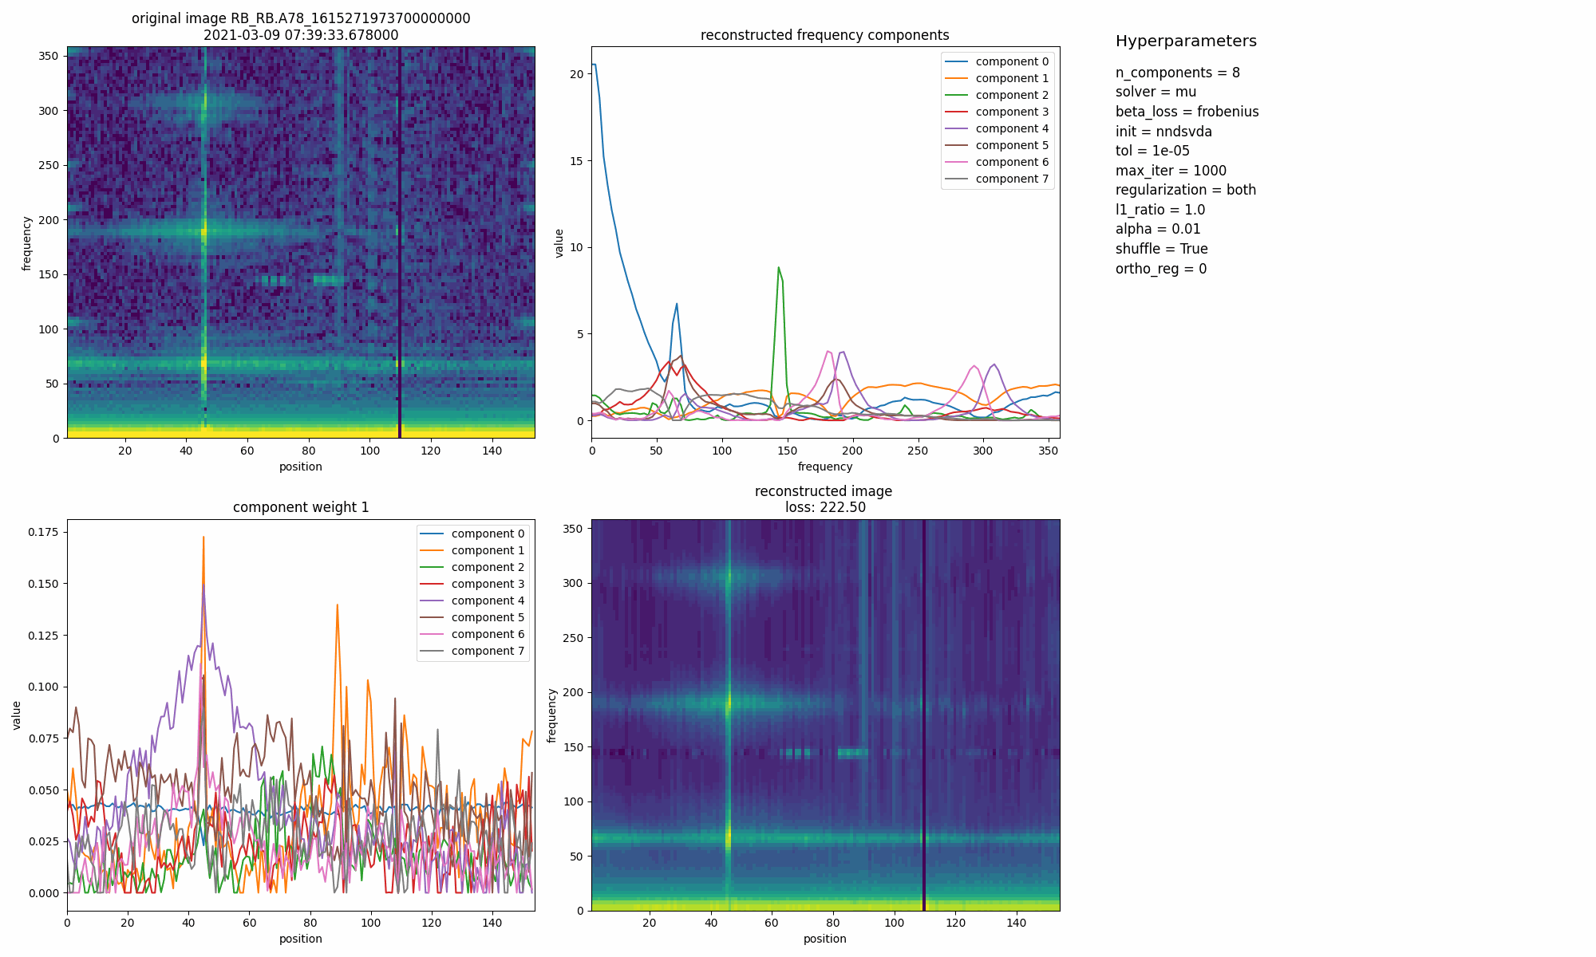
Regularization: L1 Weight

Slide 16
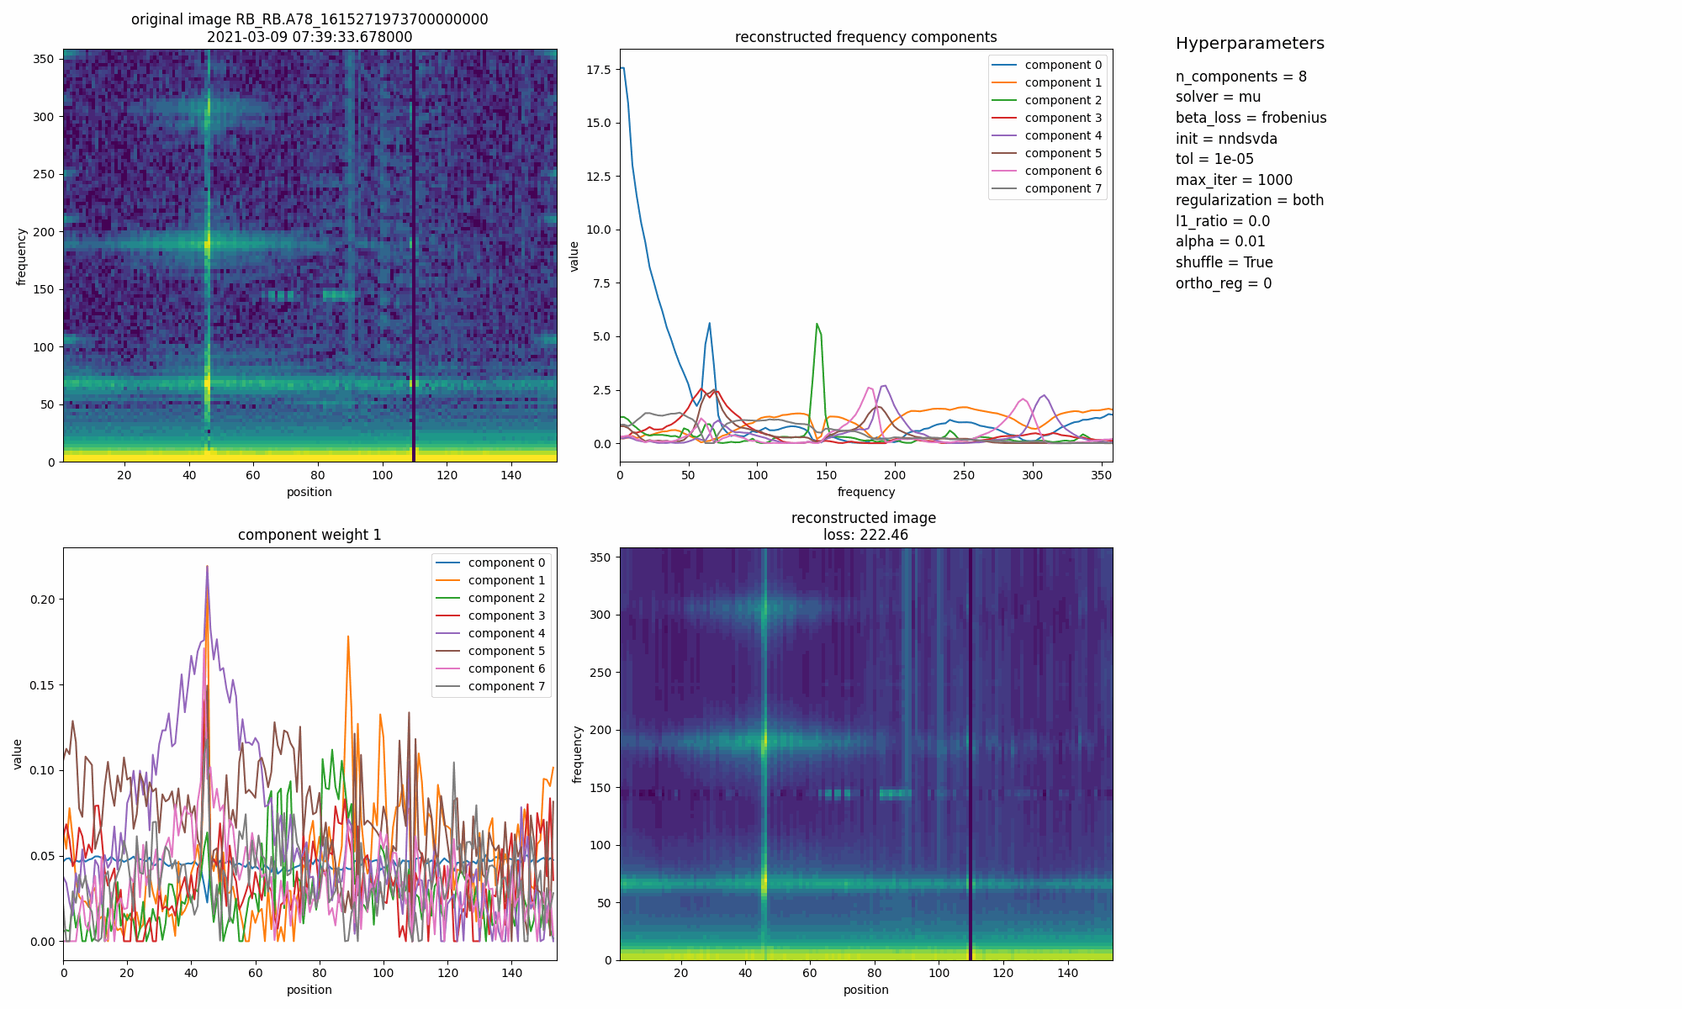
Regularization: L2 Weight

Slide 17

Regularization: L1+L2 Weight

Slide 18
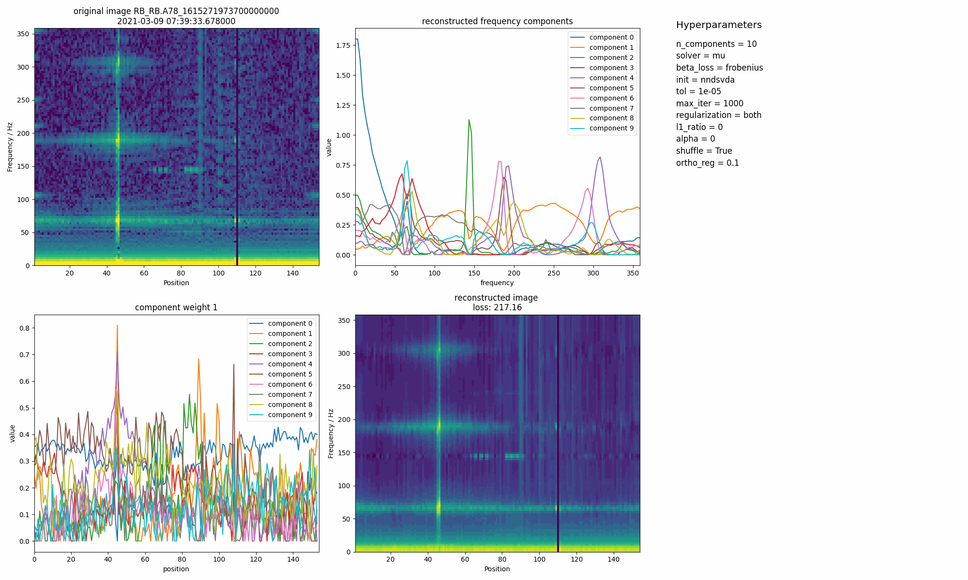
Regularization: Orthogonal Loss

Slide 19
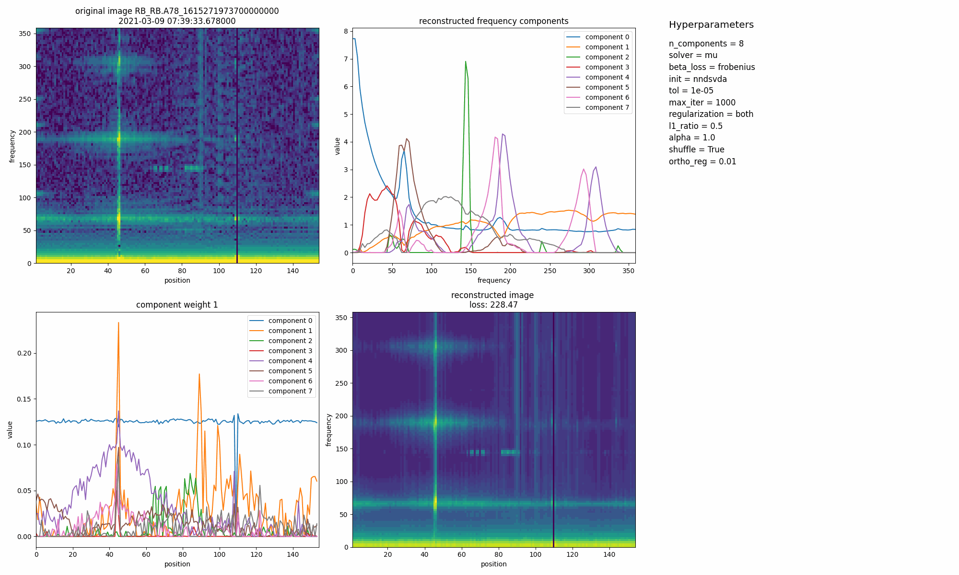
Regularization: Orthogonal Loss + L1+L2

Slide 20
Plots Hyperparameters

Slide 21
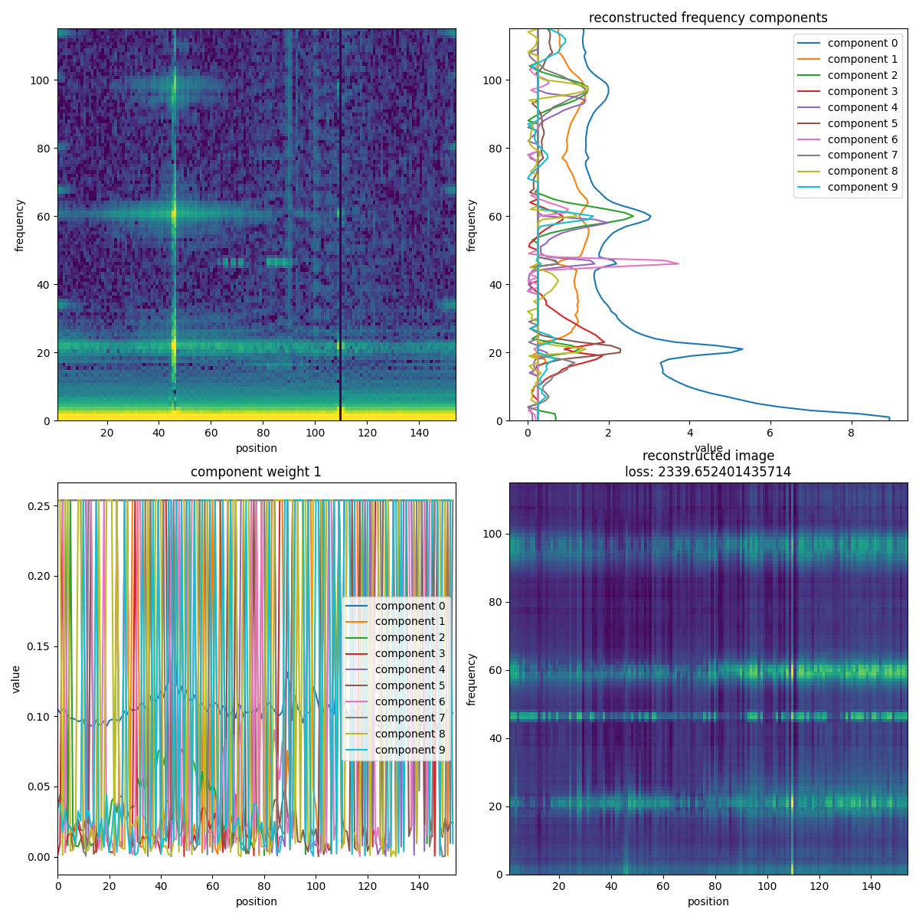
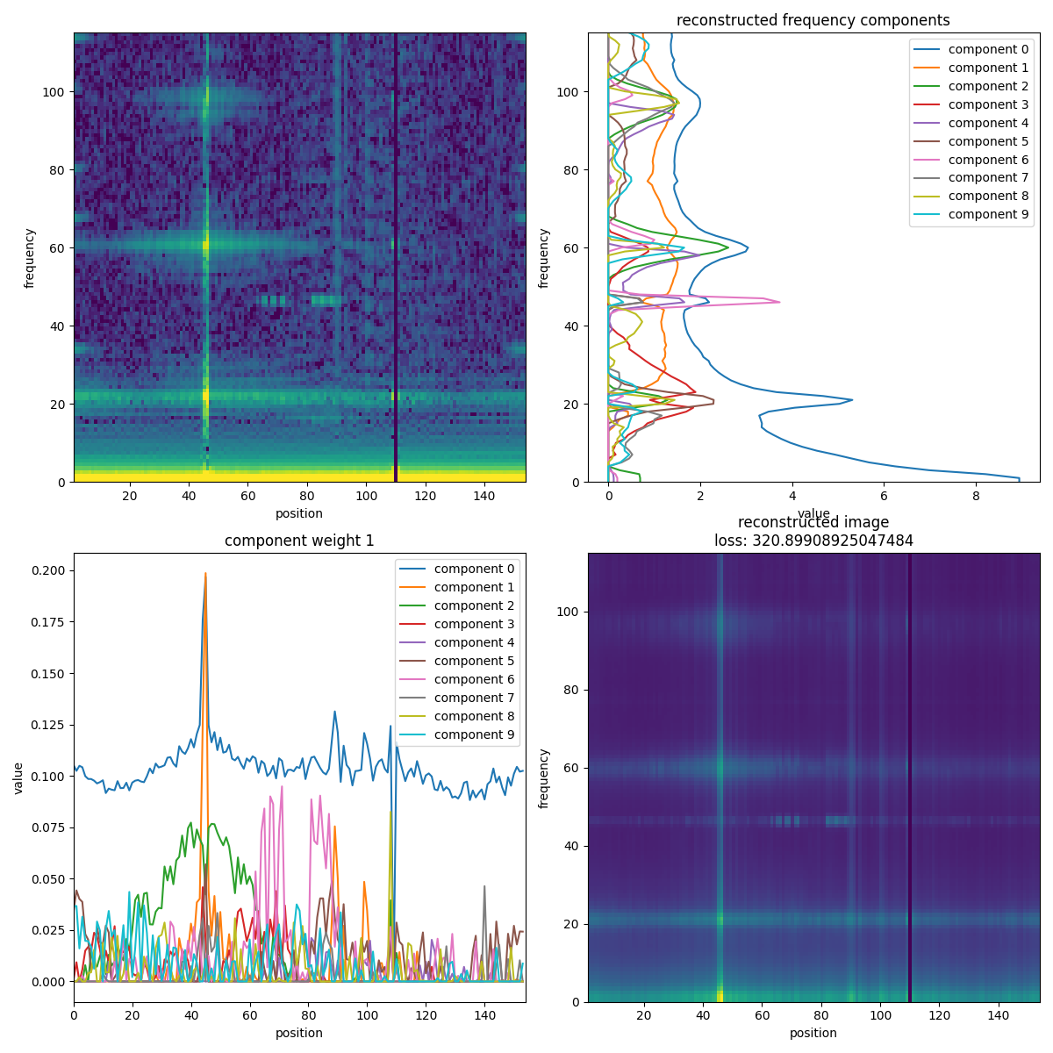
'nndsvd vs 'nndsvda'
Assumption: L1 & L2 regularization
nndsvd Initialization
nndsvda Initialization

Slide 22
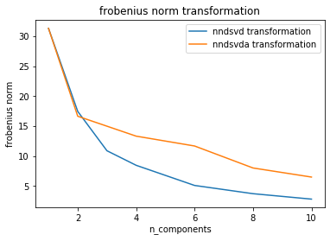
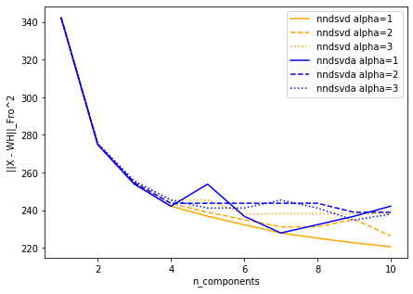
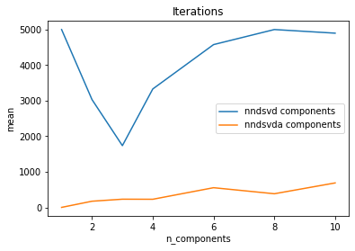
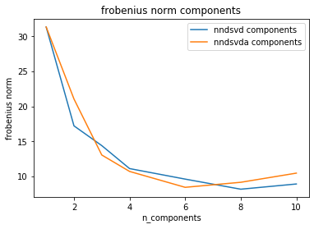
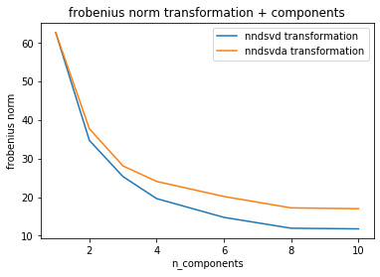
'nndsvd vs 'nndsvda'
Assumption: L1 & L2 regularization

Slide 23
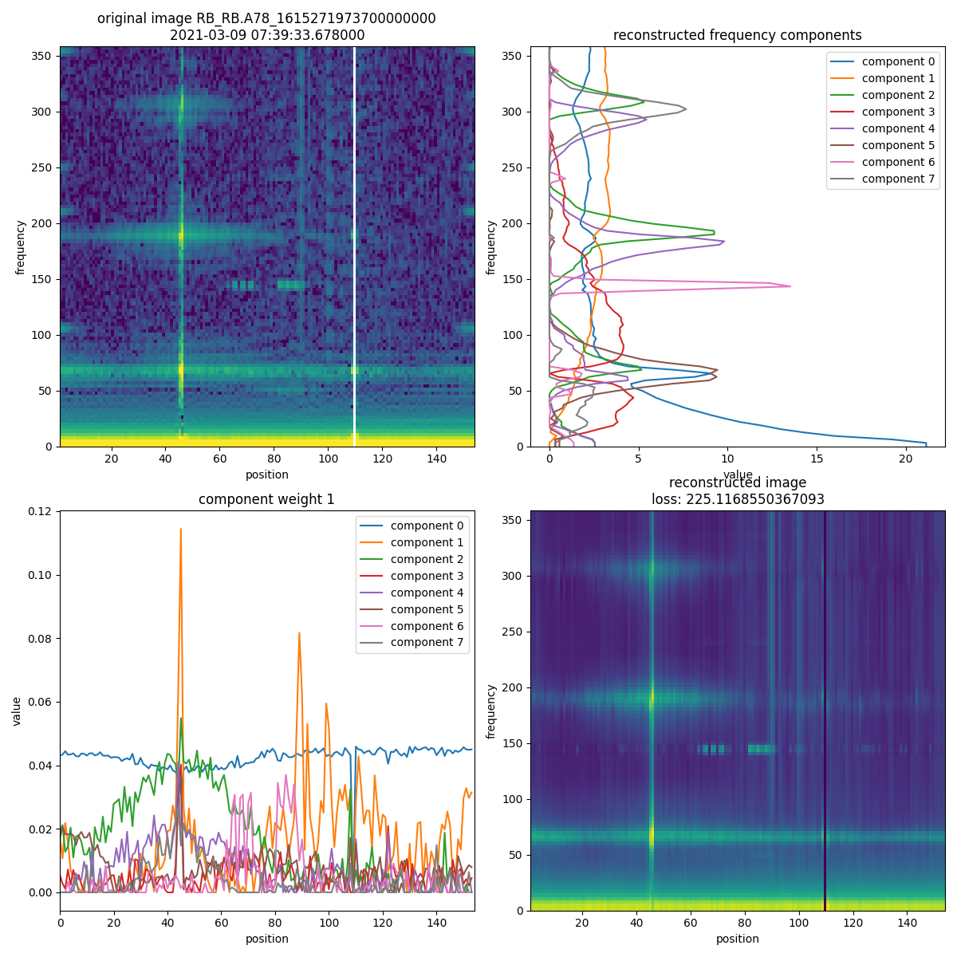
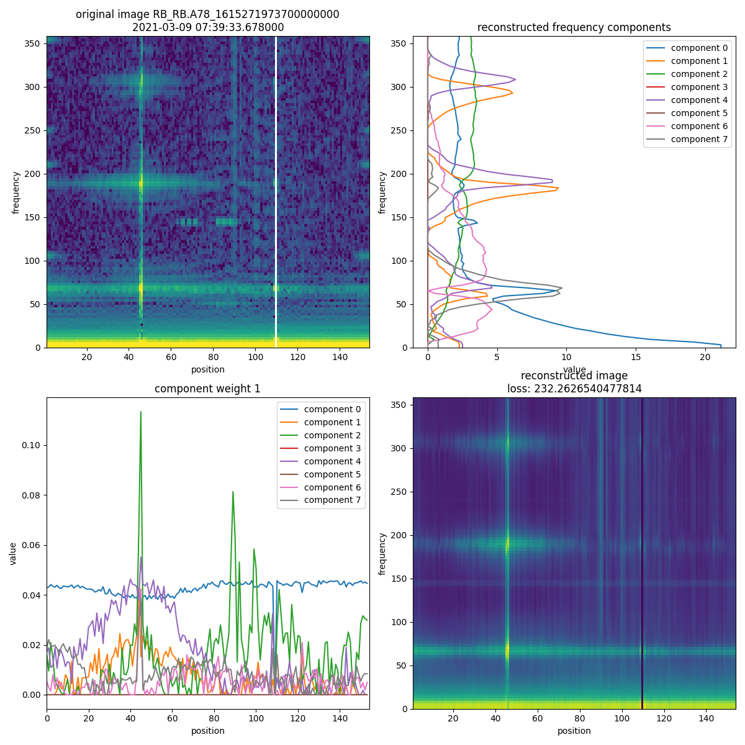
'nndsvd vs 'nndsvda'
Assumption: L1 & L2 regularization (weight =1), 8 components
Conclusion: nndsvd slightly better, nndsvda is much faster
nndsvd
nndsvda

Slide 24
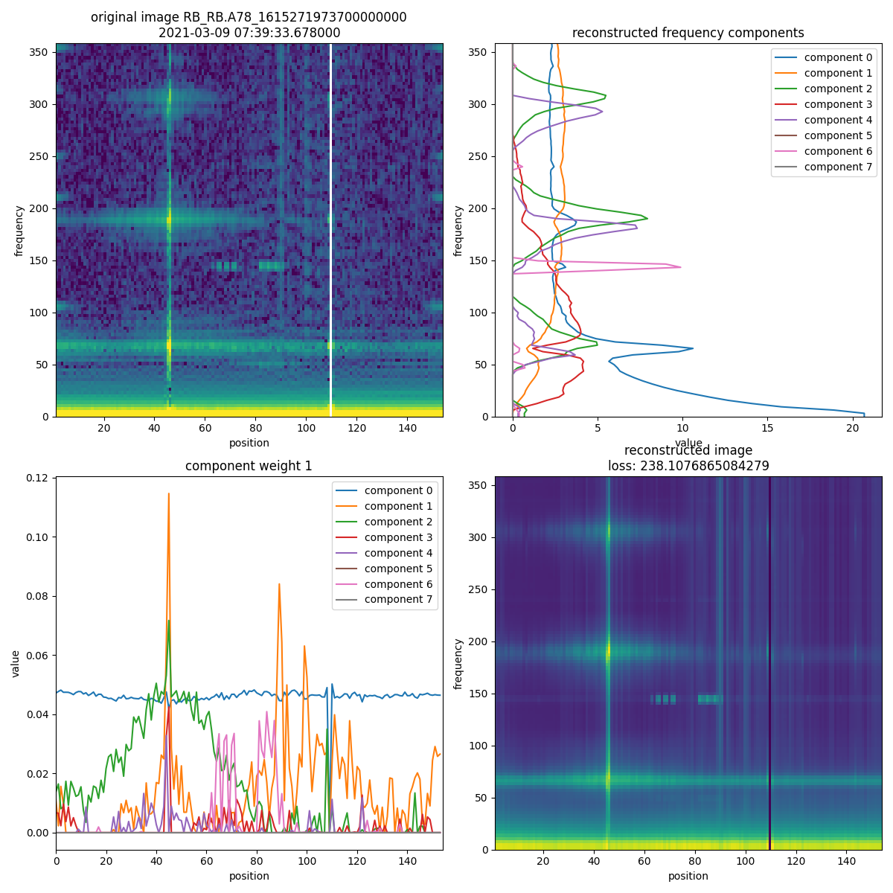
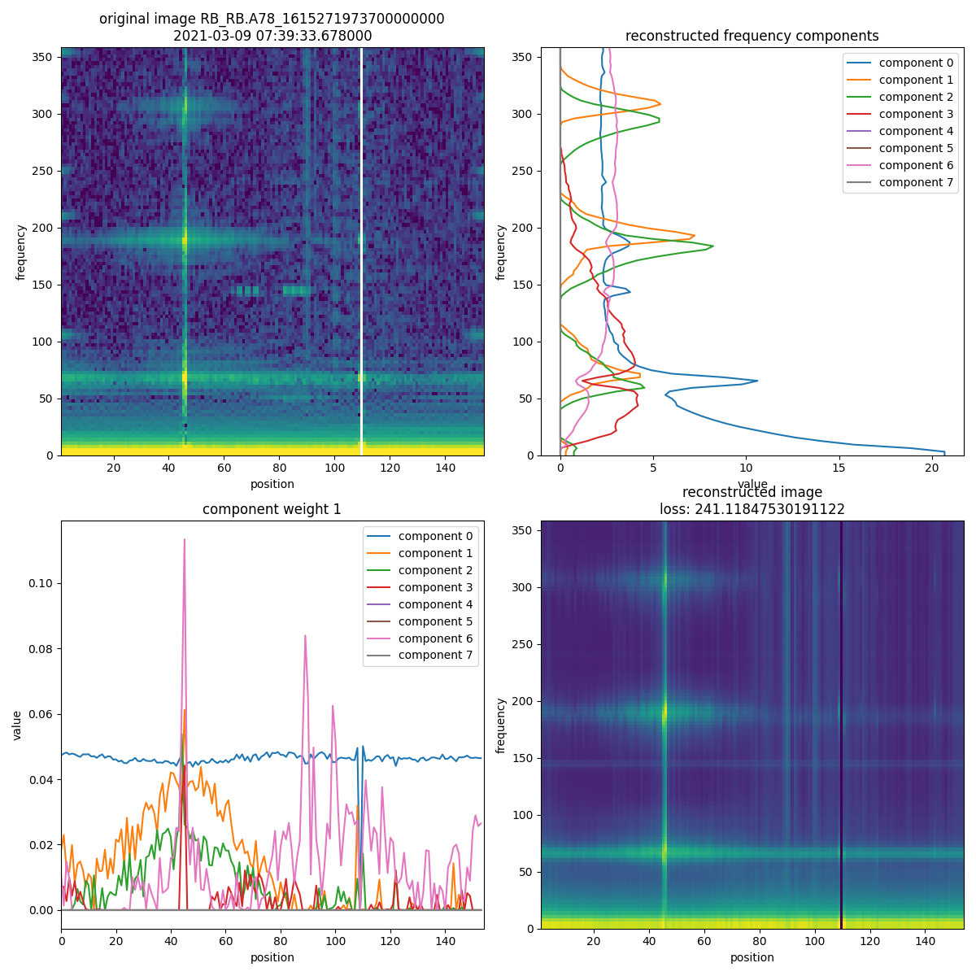
'nndsvd vs 'nndsvda'
Assumption: L1 & L2 regularization (weight =3), 8 components
Conclusion: nndsvd slightly better, nndsvda is faster (due to stopping criterion)
nndsvd
nndsvda

Slide 25
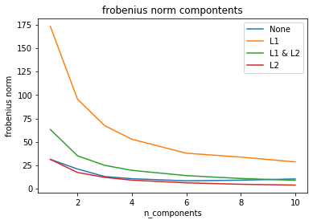
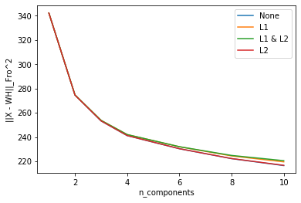
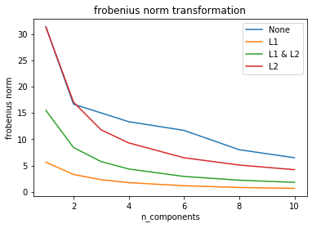
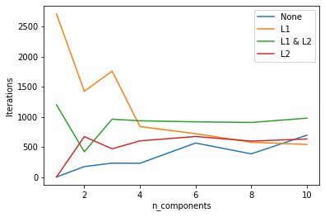
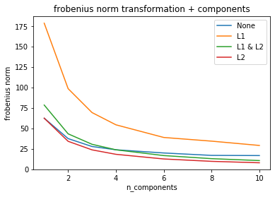
Regularization: None, L1, L1+L2, L2
Assumption: nndsvda, On Components + Transformation (W + H)

Slide 26
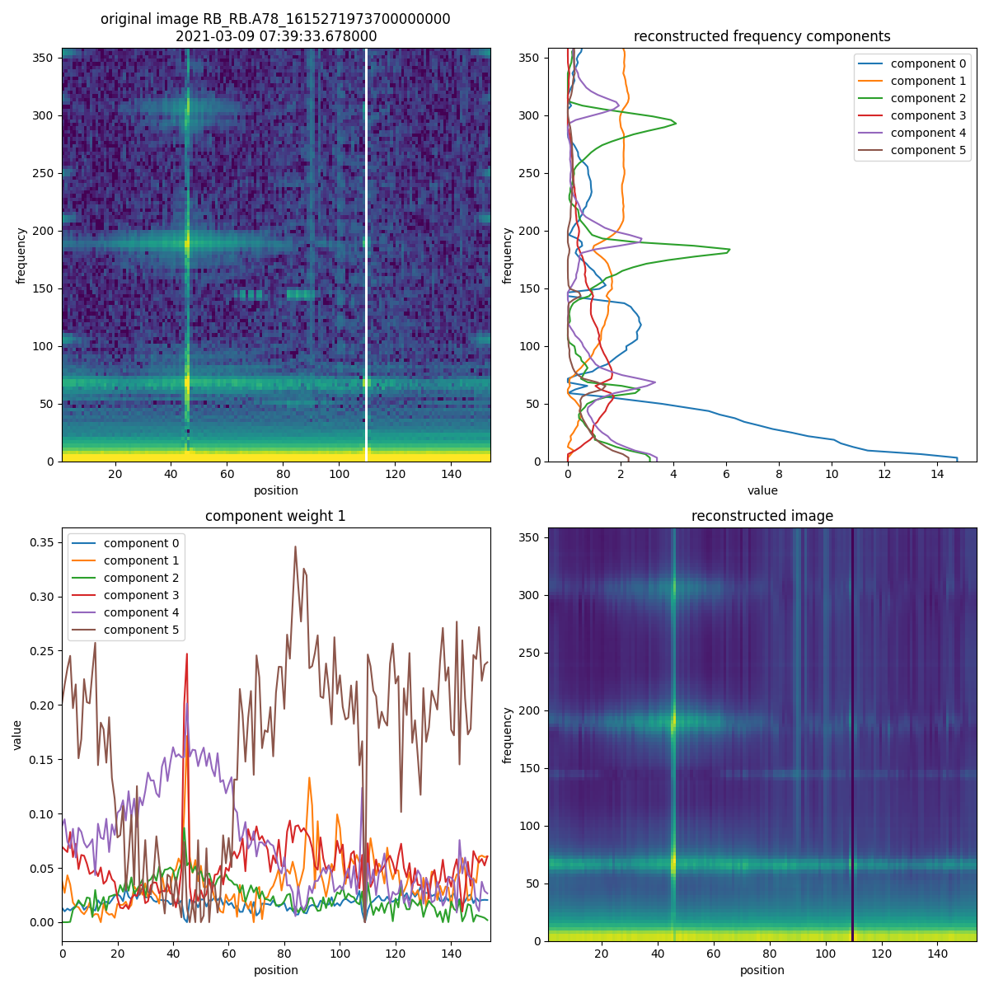
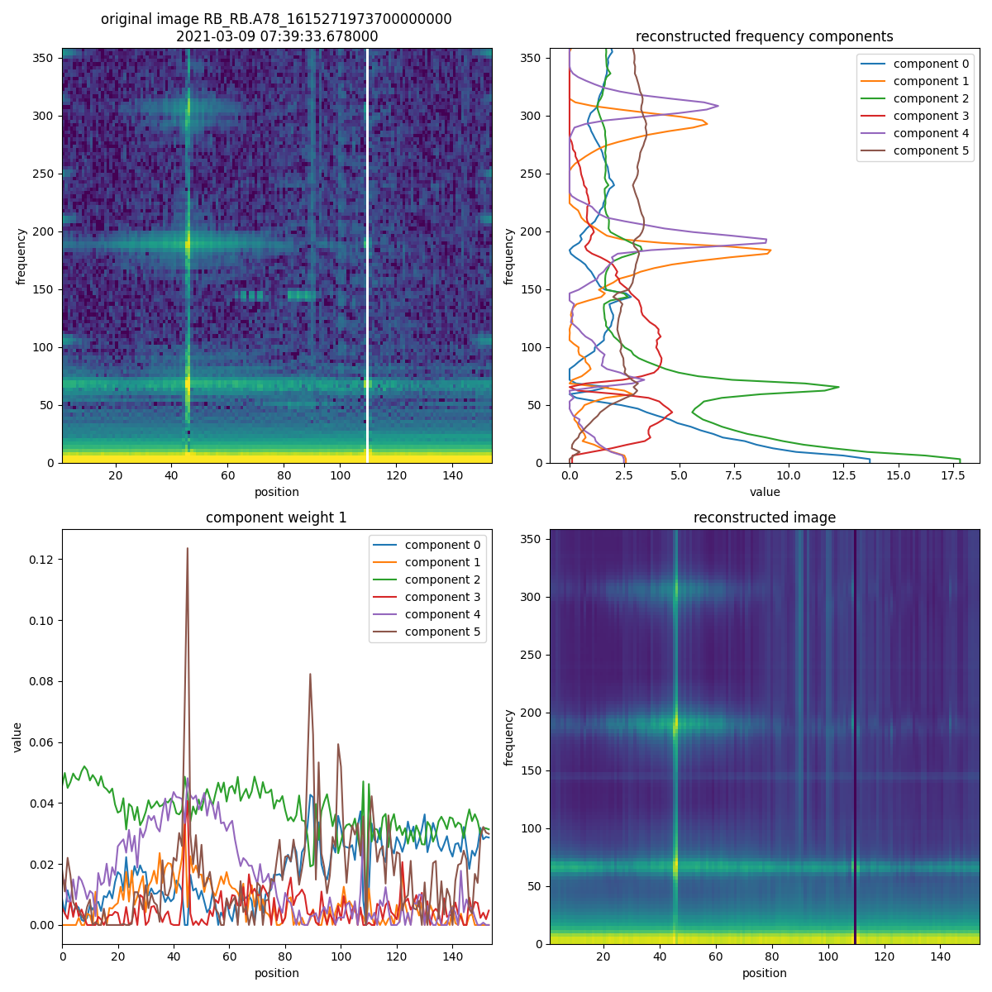
Regularization: None, L1, L1+L2, L2
Conclusion: L1+L2 lead to best result
None
L1+L2

Slide 27
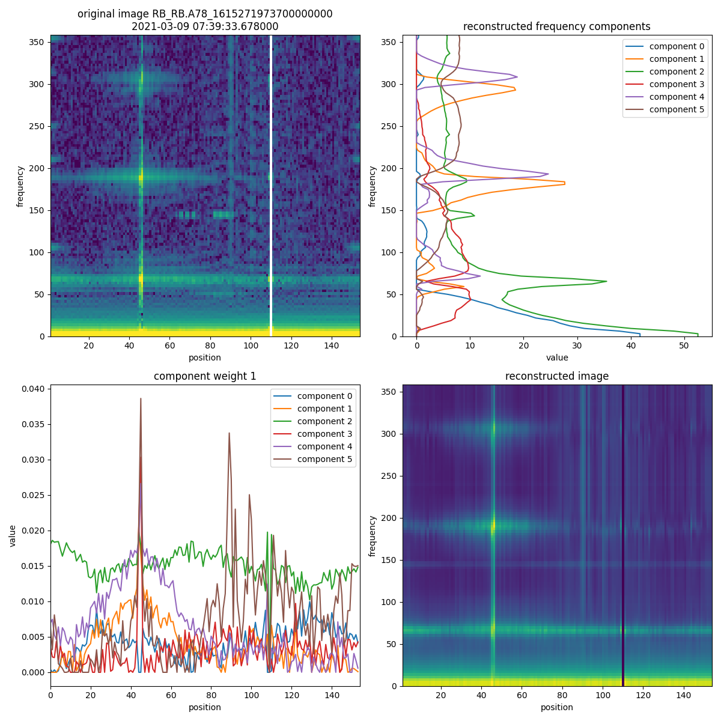

Regularization: None, L1, L1+L2, L2
Conclusion: L1+L2 lead to best result
L1
L2

Slide 28
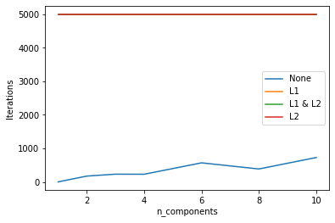
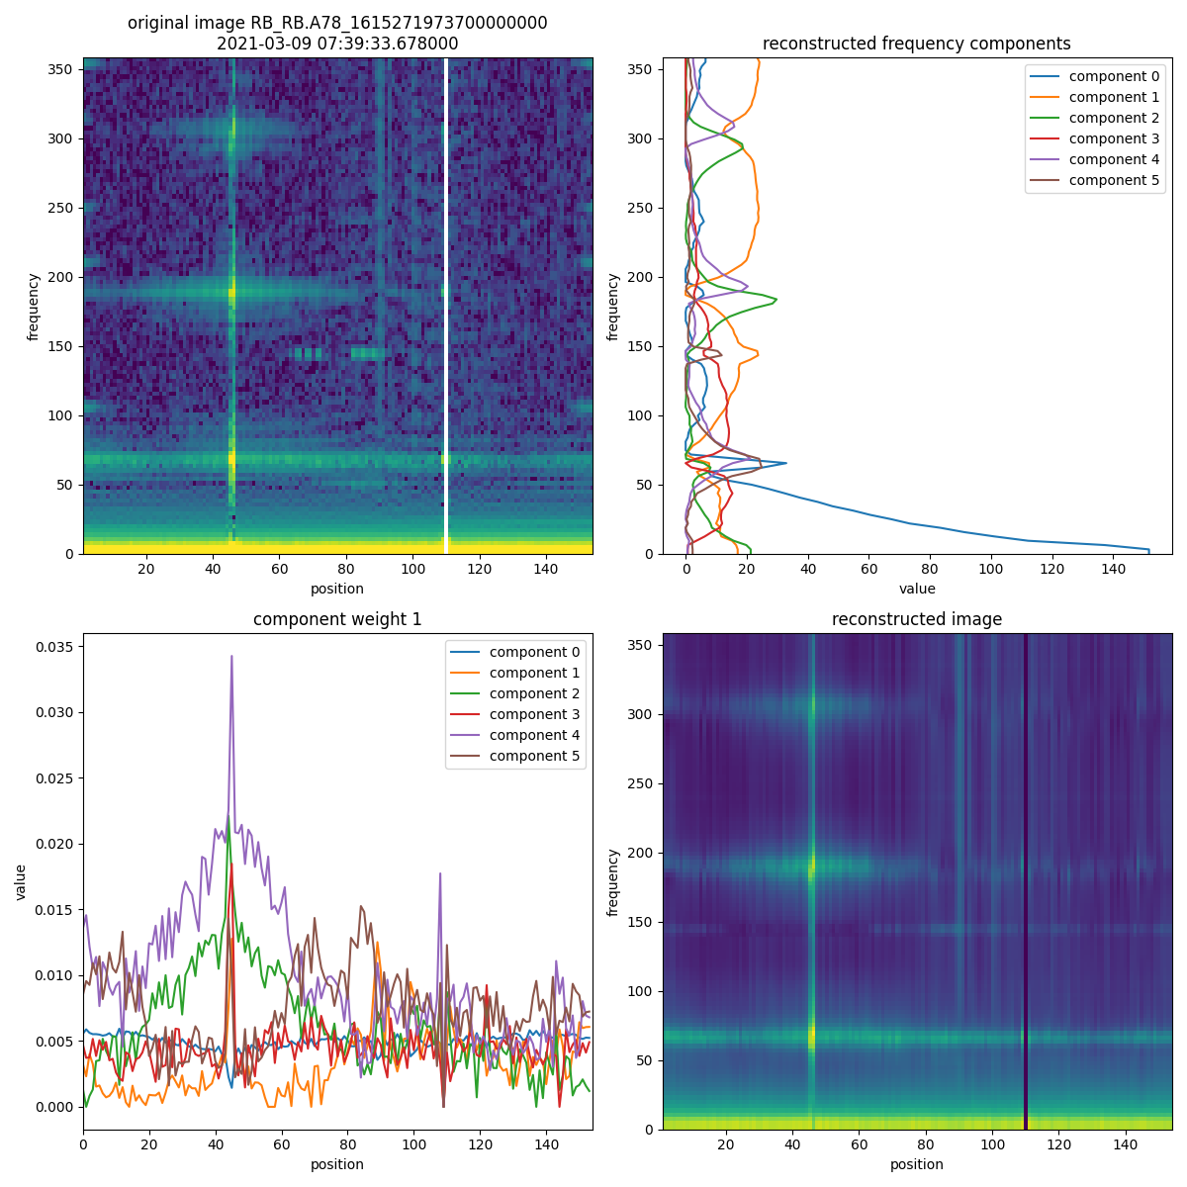
Regularization: “both”, “transformation”
Assumption: nndsvda
Conclusion: H values get smaller and smaller, does not converge
None
L1+L2 on H

Slide 29
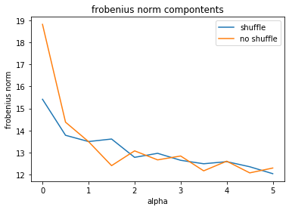
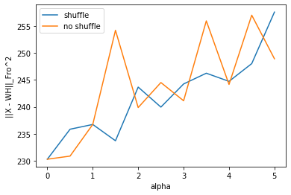
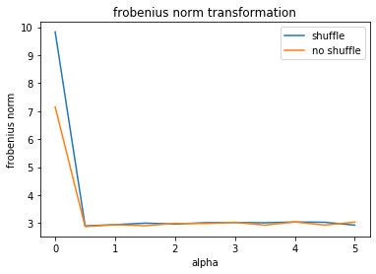
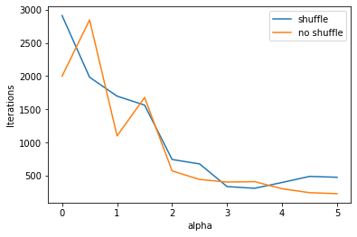
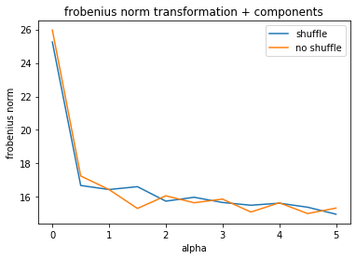
Weight & Shuffling
Assumption: nndsvda, On Components + Transformation (W + H), L1 + L2, 6 components
Conclusion: shuffling reduces variance of results
Alpha: weight of regularization

Slide 30
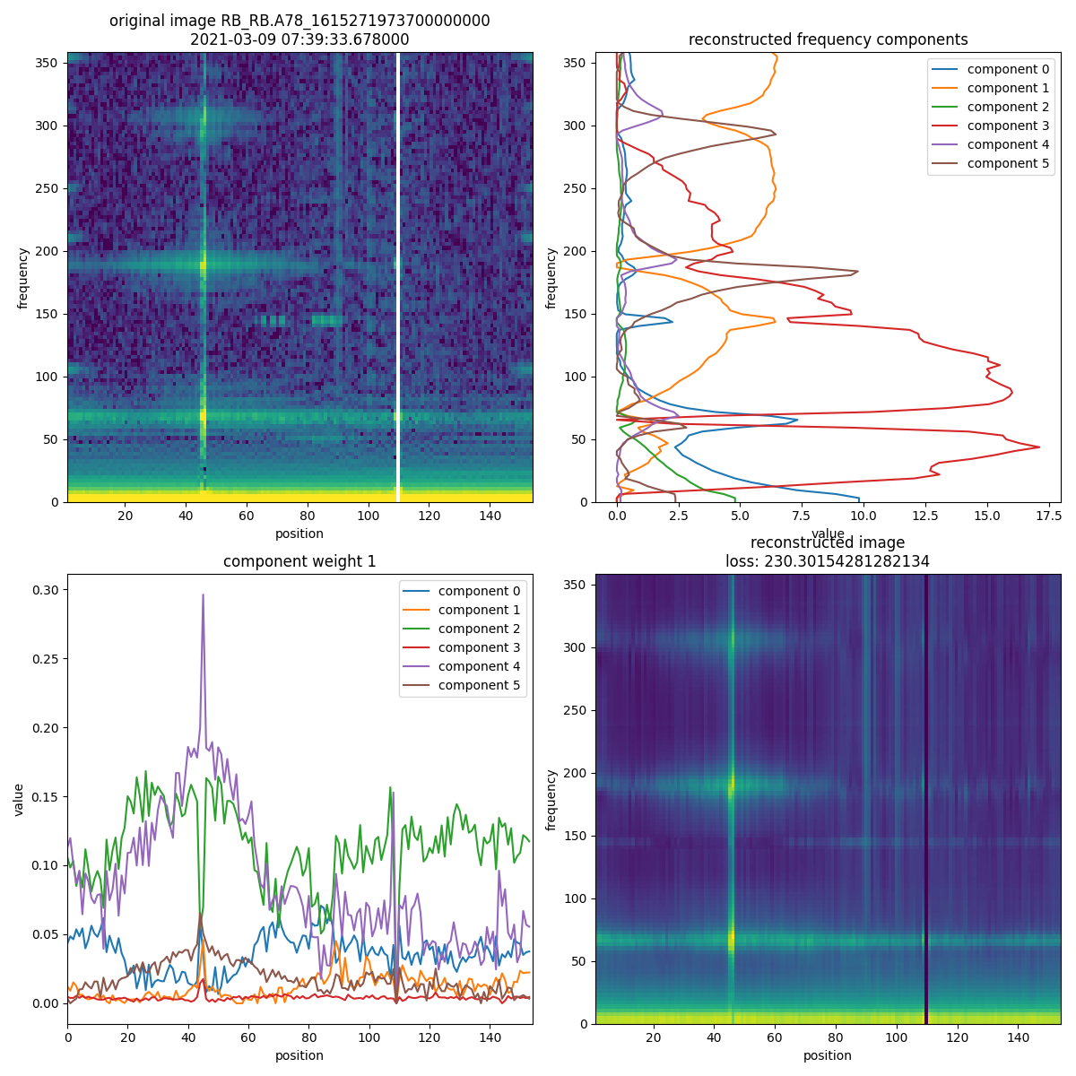
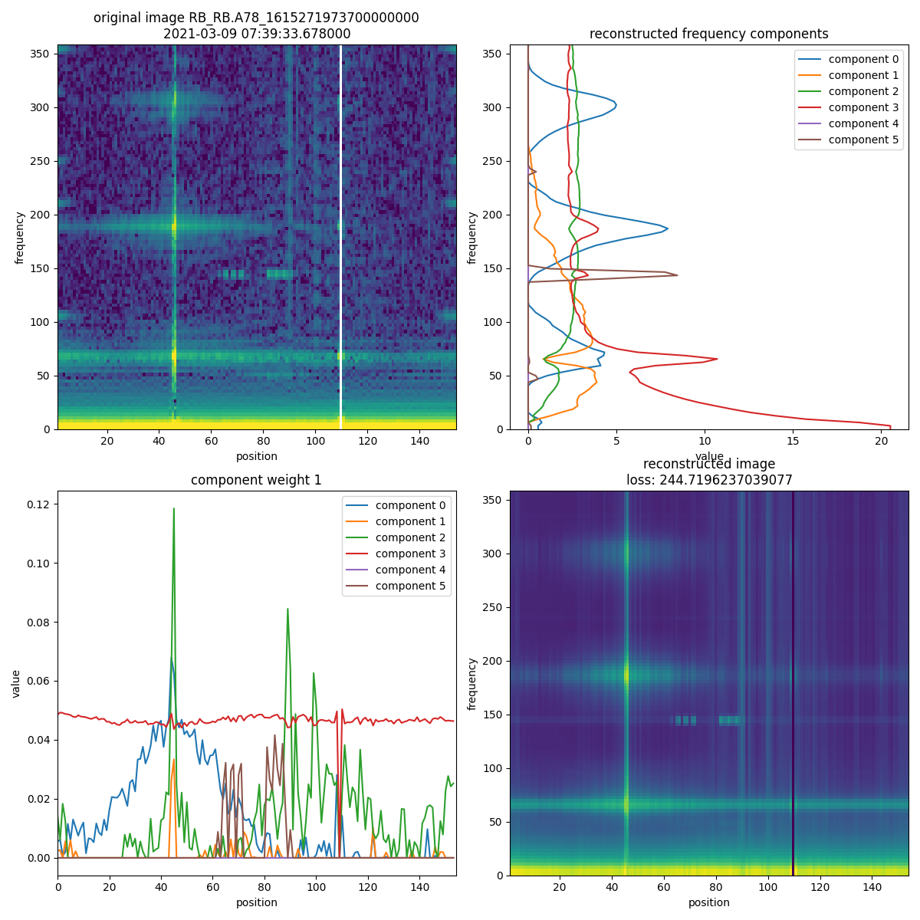
Weight & Shuffling
Assumption: nndsvda, On Components + Transformation (W + H), L1 + L2, 6 components
Conclusion: shuffling reduces variance of results
Alpha: weight of regularization
alpha = 0
alpha = 4

Slide 31
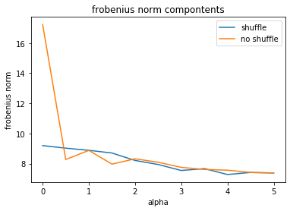
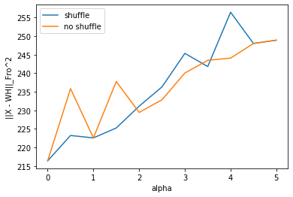



Weight & Shuffling
Assumption: nndsvda, On Components + Transformation (W + H), L1 + L2, 10 components
Conclusion: shuffling reduces variance of results
Alpha: weight of regularization

Slide 32


Weight & Shuffling
Assumption: nndsvda, On Components + Transformation (W + H), L1 + L2, 10 components
Conclusion: shuffling reduces variance of results
Alpha: weight of regularization
alpha = 0
alpha = 2.5

Slide 33




Orthogonal Loss

